Slide 1




Livestock feed types/items and related data
Presentation for Resilient African feed and fodder systems project— 2nd national feed inventory landscape and capacity building workshop
October 29, 2024
John Mutua

Slide 2
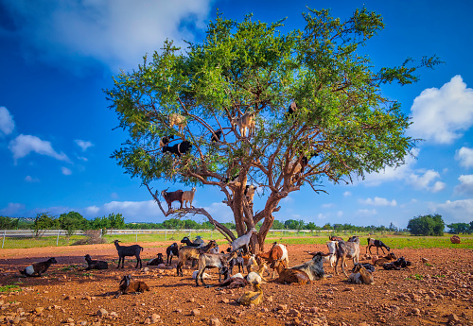
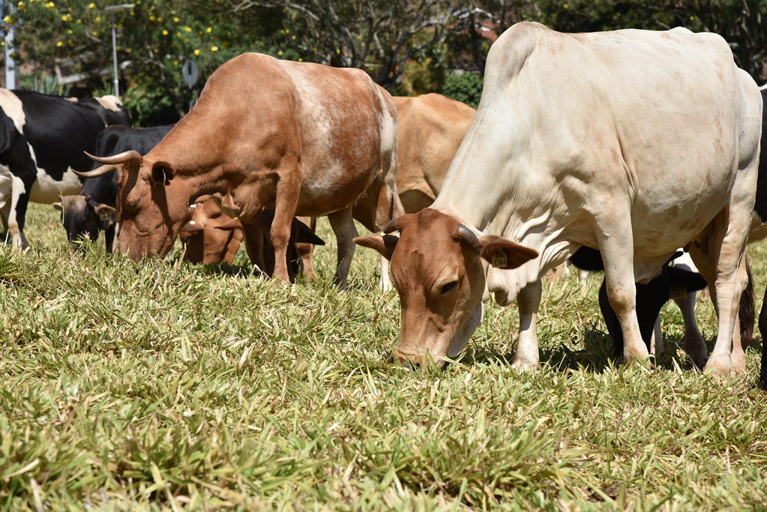
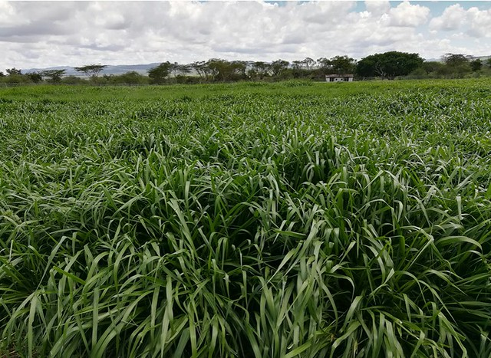
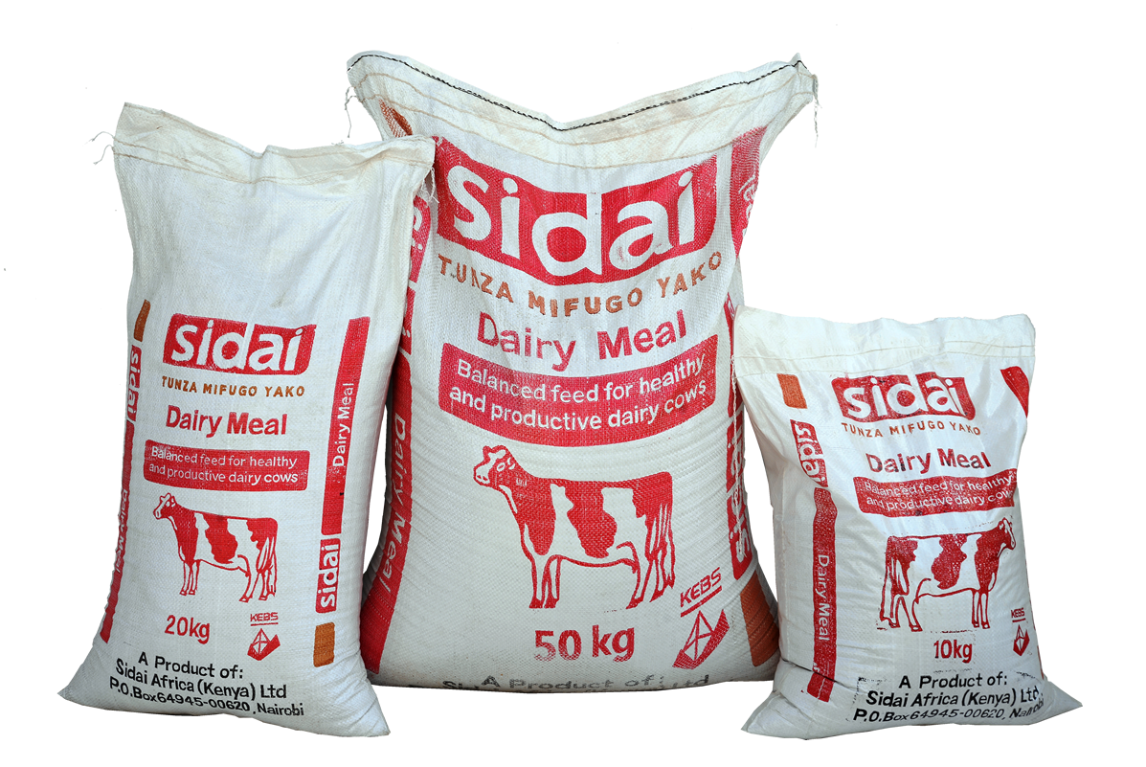
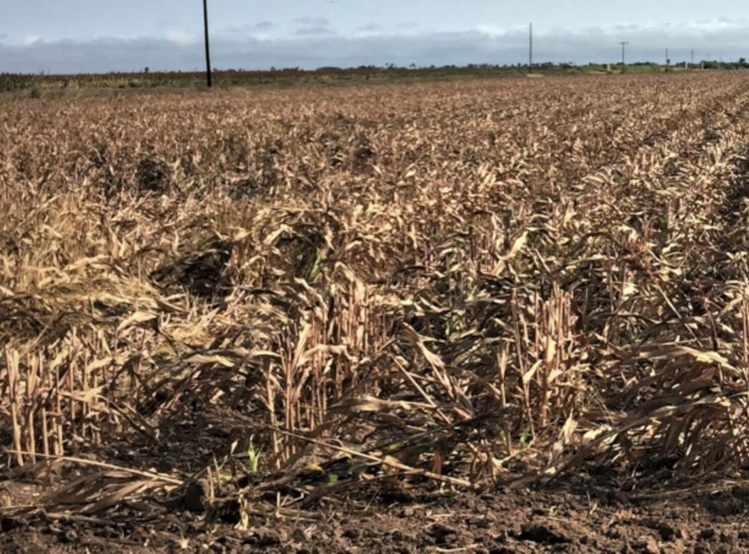
Feed items
Expert input
Defining what livestock eat

Slide 3
Feed parameters
Harvest index, ratio of the total dry weight of the grain or other harvested product to the total dry weight of the above ground biomass at plant maturity, %
Feed quality variables
Metabolizable Energy (ME), energy available to the animal and is primarily determined by digestibility of the ingredient, MJ/kg DM
Neutral detergent fiber (NDF), estimate of levels of cellulose, hemicellulose and lignin, % of DM
In vitro organic matter digestibility (IVOMD), percentage of feed that the cow digests and the percentage that leaves the cow through the manure, % of DM
Crude protein (CP), protein content of a feed, % of DM

Slide 4
Task
Identify/List feed items
Indicate data sources for feed quality parameters per feed item i.e., DM, ME, IVOMD/, NDF, CP
Country, season, Administrative unit, Agro-ecological zones, Feed item, Feed quality variable, Value, Source
Indicate data sources for harvest index per feed item
Country, Crop name, Harvest index, Source

Slide 5
Thank you

